Slide 1

Global Energy Consumption Analysis Using SQL
Presented by: Thorat Rushikesh Anil

Slide 2
About me
Name: Thorat Rushikesh Anil
Education: BCA, New Arts College, Ahilyanagar
Why I Want to Learn Data Science:
Data helps discover patterns and make smarter, evidence-based decisions.
It builds skills to turn raw information into meaningful, real-world insights.
Connect with Me:
LinkedIn: https://www.linkedin.com
GitHub: https://github.com

Slide 3
Introduction
In this project, we dove into global energy data using SQL to uncover meaningful patterns and insights:
Analyzed global energy trends to understand how consumption, production, and emissions vary across countries.
Explored the link between energy use, GDP, and population to identify top consumers and sustainability leaders.
By crafting and executing targeted SQL queries, we analyzed:
Country-specific energy consumption and emission patterns
Trends and improvements in emissions over the past decade
.

Slide 4

Objective
This project aims to uncover insights from global energy data and understand how nations consume and manage energy over time. We focus on:
Tracking how energy usage patterns change across countries and regions
Measuring production, consumption, and emissions year by year
Exploring the impact of population and economic growth on energy demand
Comparing energy use and emissions per person to highlight global differences

Slide 5
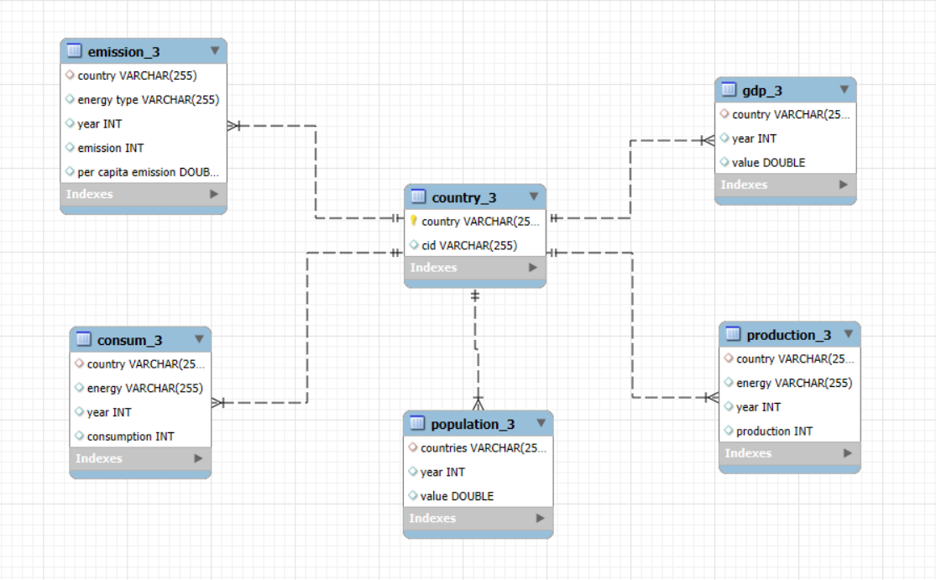
ER Diagram

Slide 6
Database Schema Overview
Table Name | No. Of Column | No. Of Rows | Primary Key | Foreign Key
Country | 2 | 231 | Country | -
Emission | 5 | 3515 | - | Country
Population | 3 | 1000 | - | Country
Production | 4 | 5294 | - | Country
Consumption | 4 | 5277 | - | Country
GDP | 3 | 1000 | - | Country

Slide 7

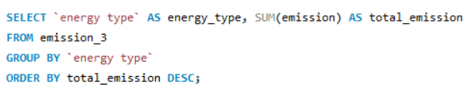
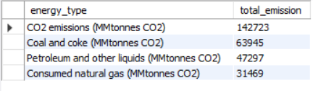
Energy types contribute most to emissions across all countries
Observation :
Coal and oil contribute the most to global emissions, followed by natural gas.
Renewable energy sources like solar and wind produce very low emissions.

Slide 8


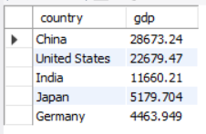
The top 5 countries by GDP in the most recent year
Observation :
The top 5 countries have the strongest and largest economies in the world.
Their high GDP reflects advanced industries and strong global trade.

Slide 9
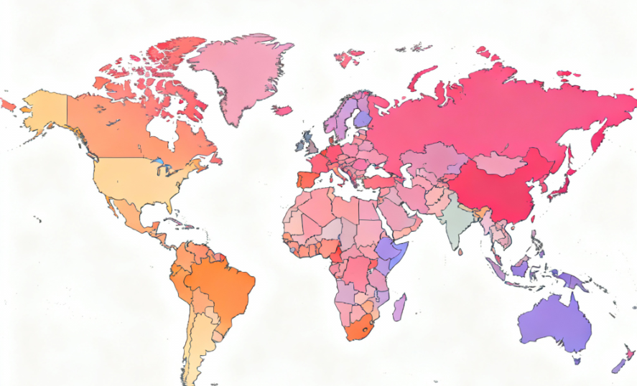
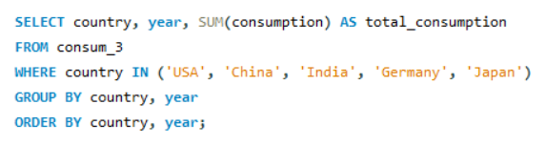
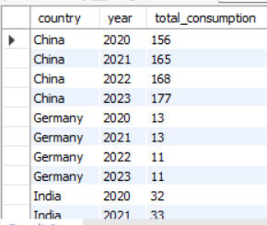
energy consumption increased or decreased over the years for major economies
Observation:
Energy consumption has generally increased over the years in major economies.
The rise is mainly due to industrial growth and higher energy demand.

Slide 10
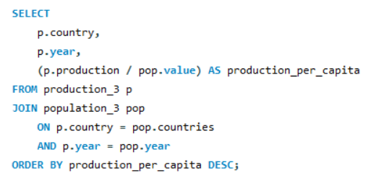
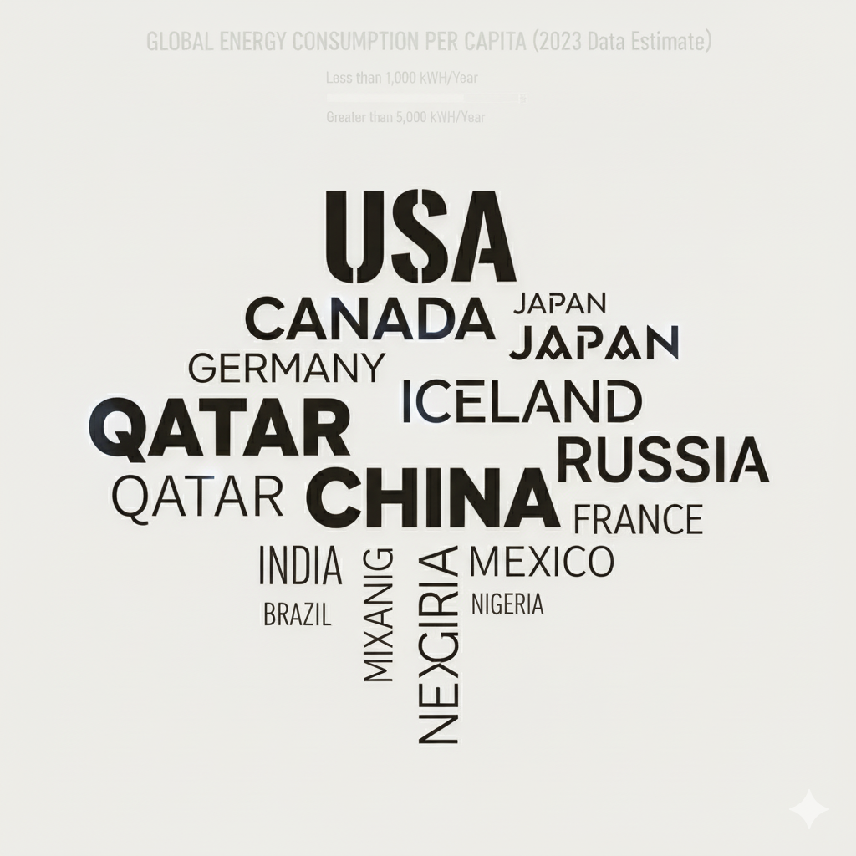
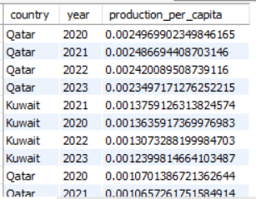
energy production per capita vary across countries
Observation :
Energy production per capita is higher in developed and resource-rich countries.
Developing countries have lower production per capita due to limited resources and infrastructure.

Slide 11


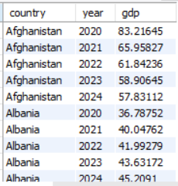
The trend in GDP for each country over the given years
Observation:
Most countries show a steady increase in GDP over the years, indicating economic growth.
A few countries may have slight dips in some years due to economic slowdowns or global factors.

Slide 12

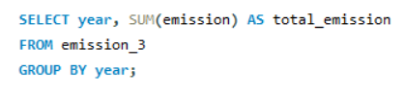
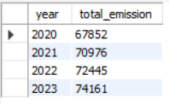
Global emissions changed year over year
Observation :
Global emissions have generally increased year over year due to rising energy demand and industrial activities.
Some recent years show a slight decline as countries adopt cleaner energy and emission control measures.

Slide 13
Business Insights
Countries with higher energy consumption often have larger industries and urban populations.
Rising energy use indicates growing economic activity and potential market opportunities.
Efficient energy use can reduce costs and improve competitiveness.
Transitioning to renewable energy can lower emissions and enhance sustainability credentials.

Slide 14
Experiences & Challenges
Experience:
Learned to analyze global energy, GDP, and population data effectively.
Gained skills in SQL queries and data visualization for trends and comparisons.
Challenges:
Handling large datasets with multiple tables and ensuring accurate joins.
Interpreting trends across countries with different energy and economic profiles.

Slide 15
Conclusion
Energy usage and production vary significantly across nations.
Economic growth strongly influences energy demand and efficiency.
Developing regions are rapidly expanding their energy consumption.
Carbon emissions remain a key global environmental concern.
Transitioning to renewable energy is essential for sustainable development.

Slide 16

THANK YOU

